Slide 1
Deposition trends in Europe for the period 1990-2010, in the framework of the EURODELTA III project
M. Theobald, M. Garcia Vivanco, A. Colette, F. Couvidat, K. Cuvelier, B. Bessagnet, A. Manders, M. Mircea, K. Mar, M.T. Pay, V. Raffort, L. Rouïl, Y. Roustan, S. Tsyro,
Thanks to Nilu for observations (W. Aas)
17th Task Force on Measurement and Modelling Meeting
Utrecht, 18-20 May , 2016
Notes:
Please revise author list

Slide 2
Outline
Aims of the study
Observed/modelled trends in wet deposition for the period 1990-2010
Model performance assessment
Relationship with atmospheric concentrations and precipitation
Influence of meteorological variability
Conclusions

Slide 3
Questions to answer
Can the models estimate wet deposition for the period 1990-2010 with sufficient accuracy?
Can the models reproduce the observed trends in wet deposition?
What are the reasons for the differences between the models and between modelled and observed trends?

Slide 4
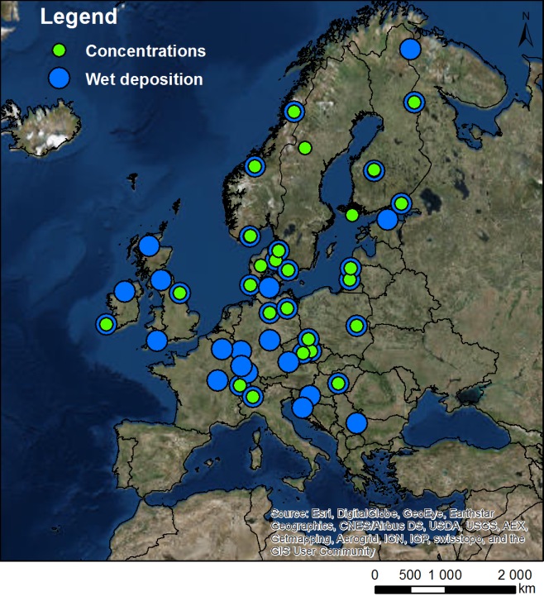
Datasets Used
Variables (annual, seasonal)
Wet deposition of oxidised N (WNOx) Wet deposition of reduced N (WNHx) Wet deposition of S (WSOx)* Total oxidised N = HNO3 + NO3-10 (TNO3) Total reduced N = NH3 + NH4-10 (TNH4) Total sulphur = SO2 + SO4-10 (TSO4) * Precipitation
* Not including sea-salt sulphate
Simulations (1990-2010)
Chimere (CHIM) EMEP MSC-W (EMEP) Lotos-Euros (LOTO)
Simulations (1990, 2000, 2010)
Chimere (CHIM) CMAQ (CMAQB) EMEP MSC-W (EMEP) Lotos-Euros (LOTO) MINNI Polair3D (POLR) WRF-Chem (WRFC)
Observations (EMEP sites: 1990-2010)
Wet deposition (41 sites) Precipitation (41 sites) Concentrations (29 sites)
+ Simulations with constant emissions (2010)
Notes:
Sulphur measurements are sea-salt sulphate corrected
Observations provided by Wenche (NILU)
WRF-Chem is participating in the exercise but the data have not been included in this analysis

Slide 5
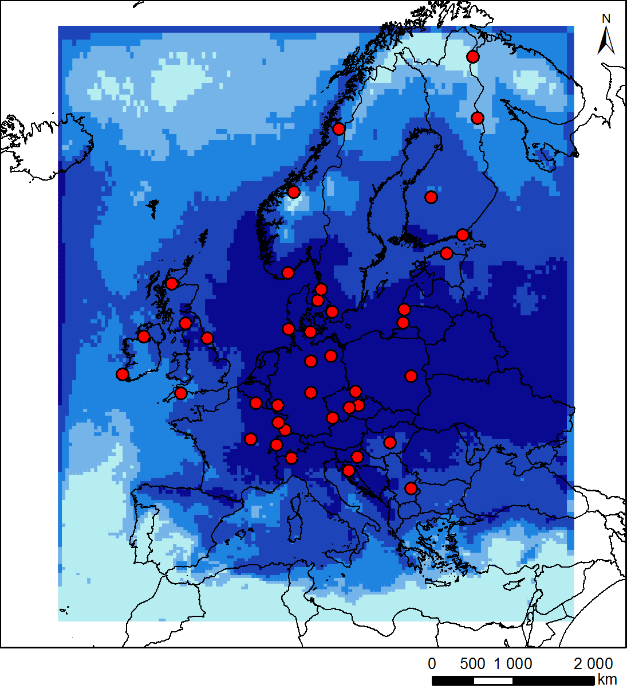
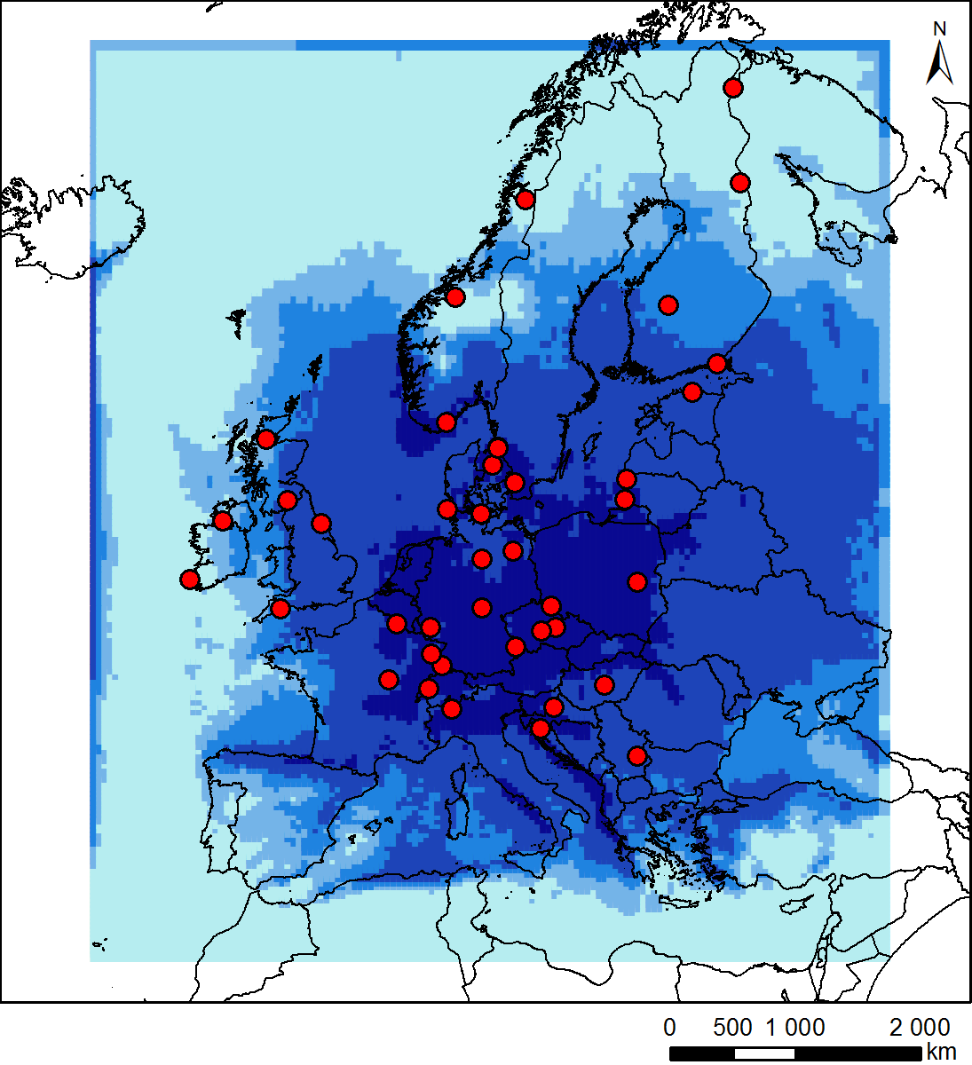
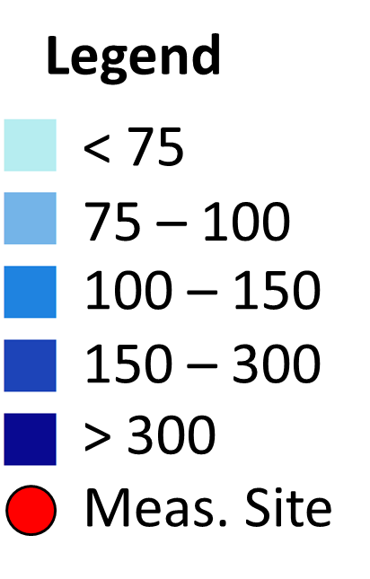
21 year time series (1990-2010)
e.g. EMEP - WNOx (mg N m⁻² yr⁻¹)
1990
2010
Notes:
Example just to show the type of model output used and the spatial distribution of observations relative to the model domain (i.e. none in S and E of the domain

Slide 6
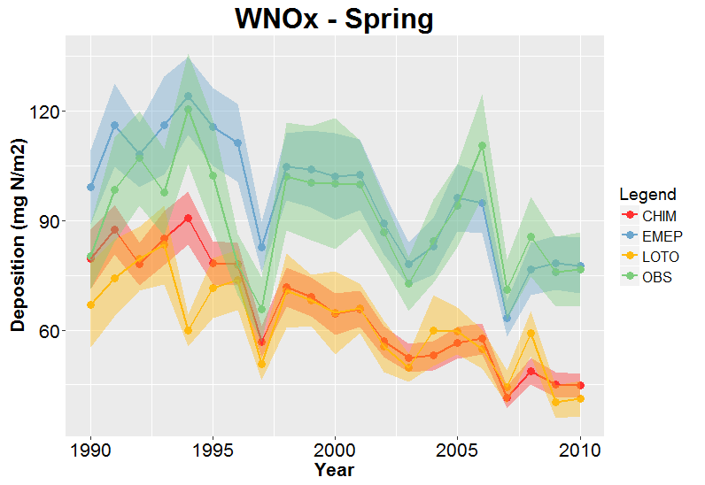
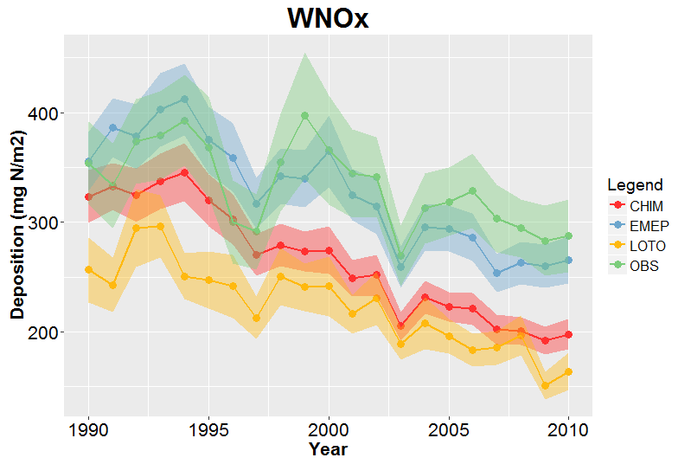
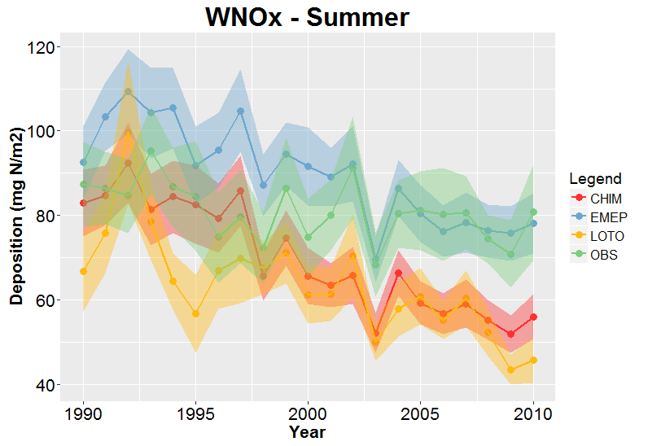
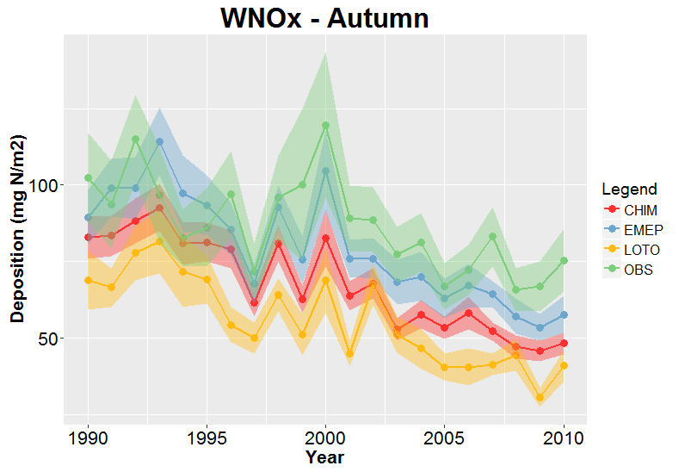
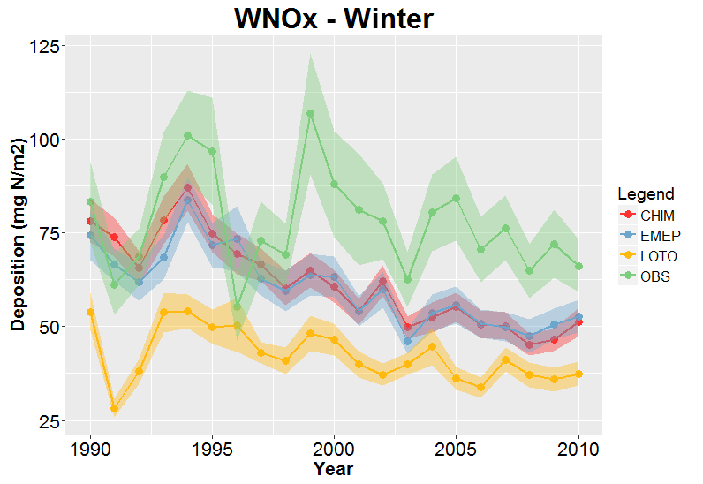
21 year time series (1990-2010) – Mean of all sites
By season
WNOx (mg N m⁻² yr⁻¹)
Notes:
Observed (green) and modelled wet deposition averaged over all measurement sites
Line: Mean, Shaded: +/- one standard error
EMEP > CHIM > LOTO
EMEP similar to observed (especially in Spring, not so in Winter). LOTO significantly lower (especially in Winter)

Slide 7
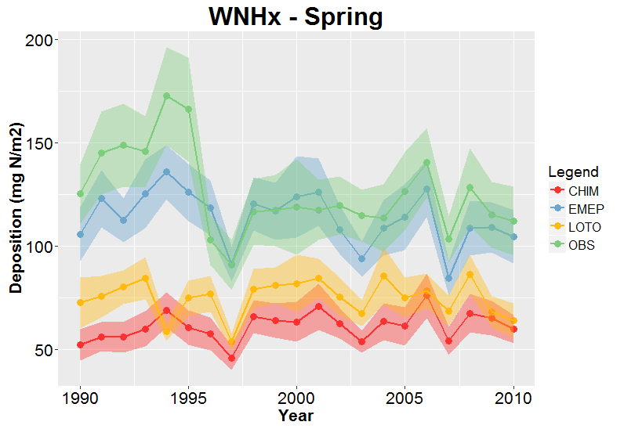
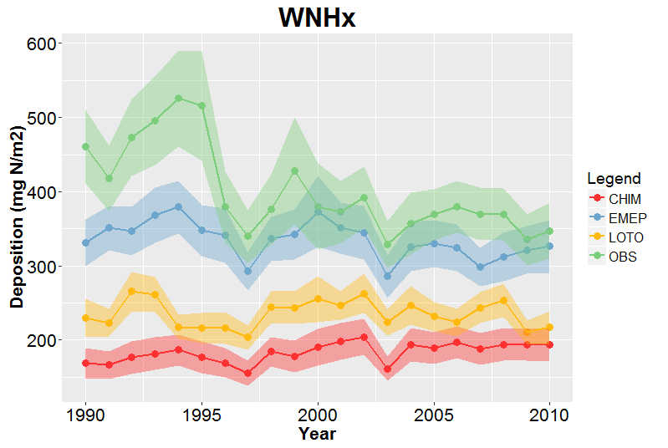
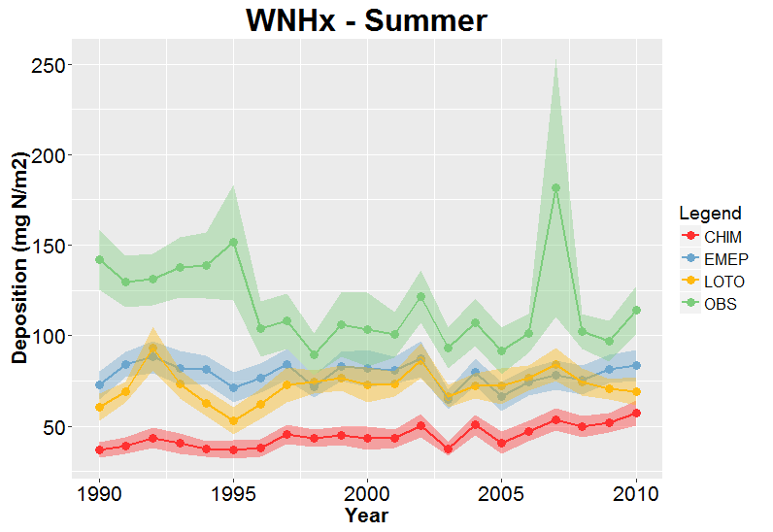
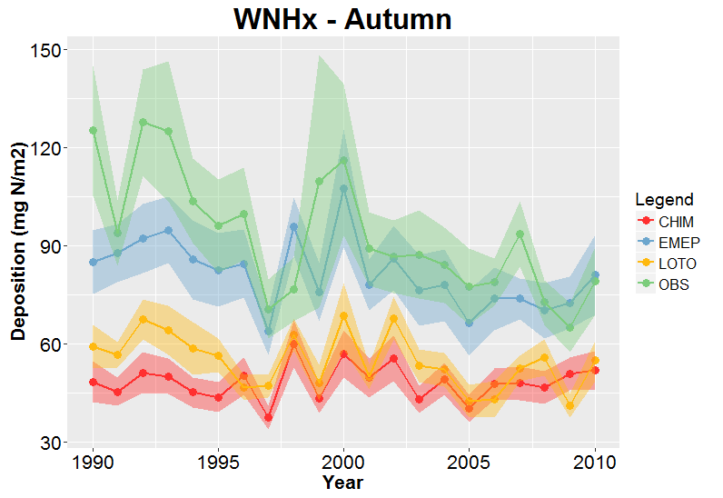
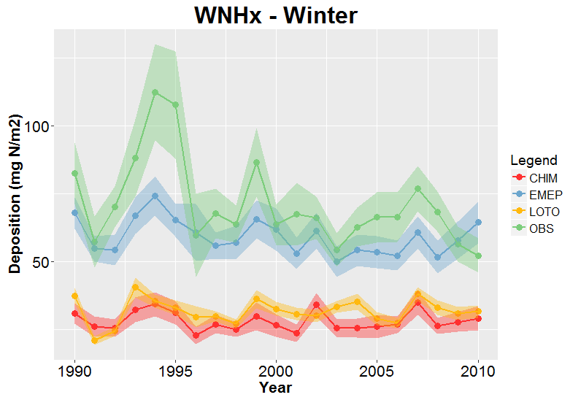
21 year time series (1990-2010) – Mean of all sites
By season
WNHx (mg N m⁻² yr⁻¹)
Notes:
EMEP similar to observed except for period 1990-1995
EMEP > LOTO > CHIM
CHIM similar to LOTO in Winter

Slide 8
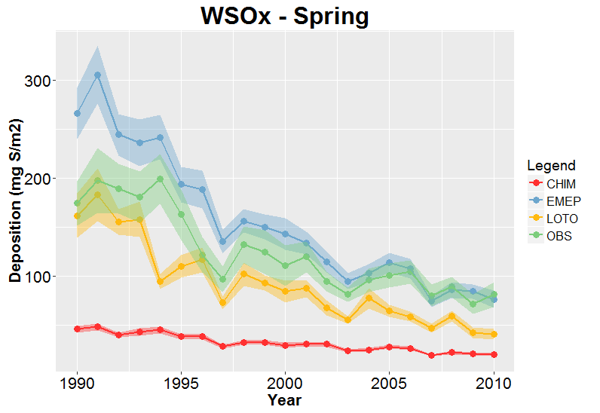
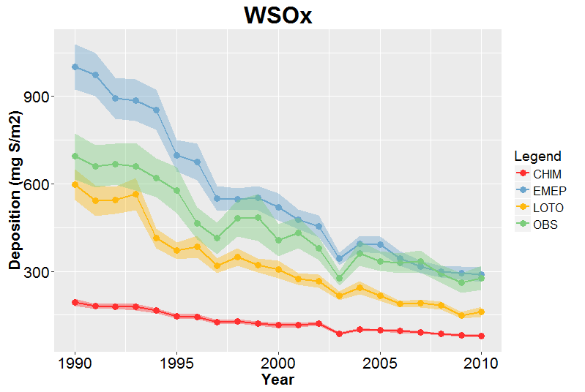
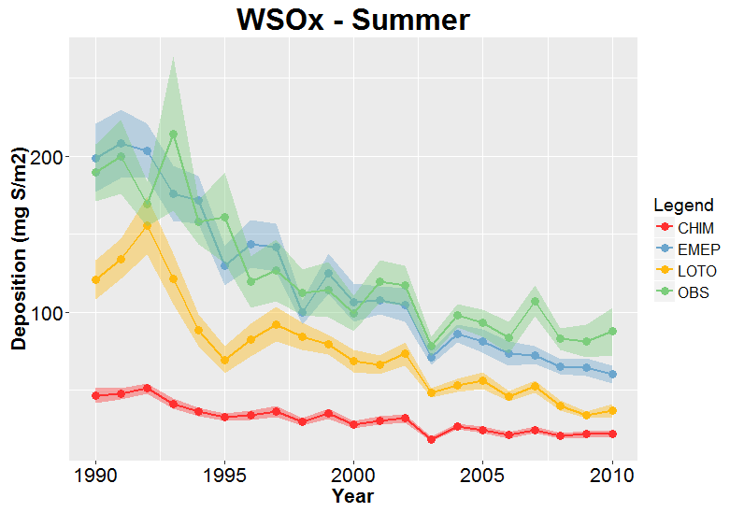
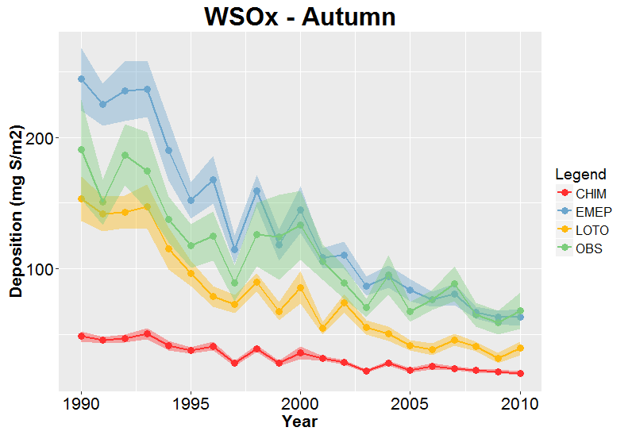
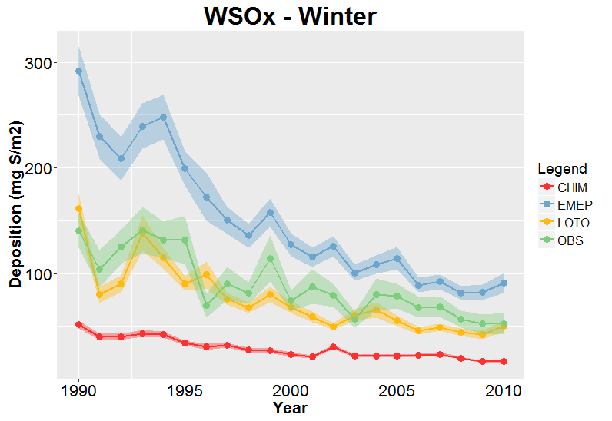
21 year time series (1990-2010) – Mean of all sites
By season
WSOx (mg S m⁻² yr⁻¹)
Notes:
EMEP > LOTO > CHIM
EMEP starts higher than OBS but the difference gets smaller with time (2010 almost equal)
Largest obs – model difference in Winter

Slide 9
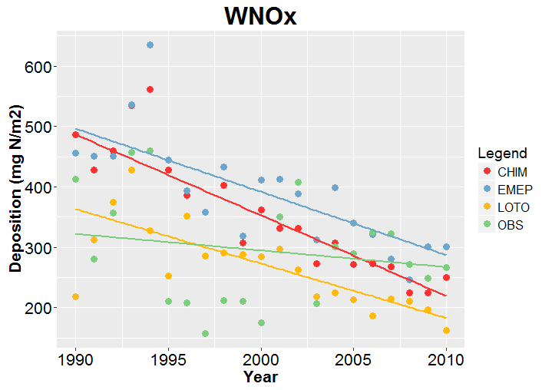
21 year time series (1990-2010) – Trends
Conditions: Observations for > 75% of period
Trend calculation: Sen’s slope method
Relative trend = Trend/Estimated value at start of period
Trend significance: Mann Kendall method (p < 0.05)
e.g. Randomly chosen site
(DE002R)
Relative trends (yr⁻¹)
-2.7% (***)
-2.1% (***)
-2.5% (***)
-0.9% (ns)
Notes:
Linear trends have been assumed (might not be valid for WSOx)
Need to point out that there are two trends: the absolute trend (in mg N (or S) /m2/yr) and relative trend (in %/yr)
We have focussed on the relative trends although a complete analysis should consider both

Slide 10
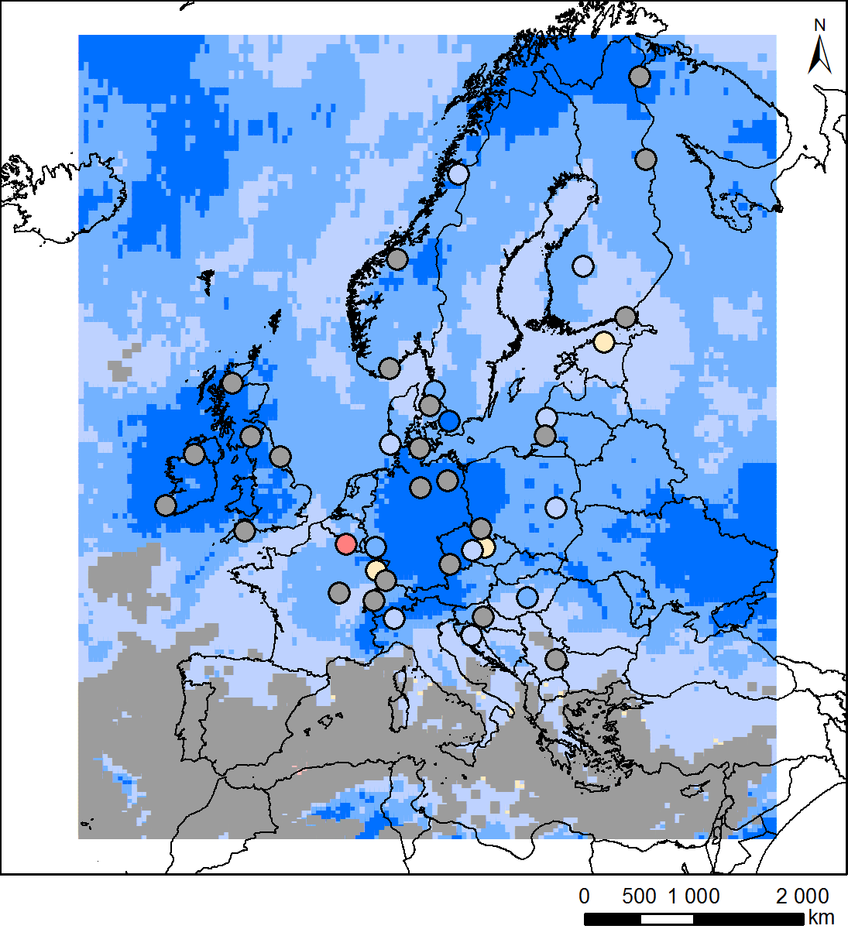
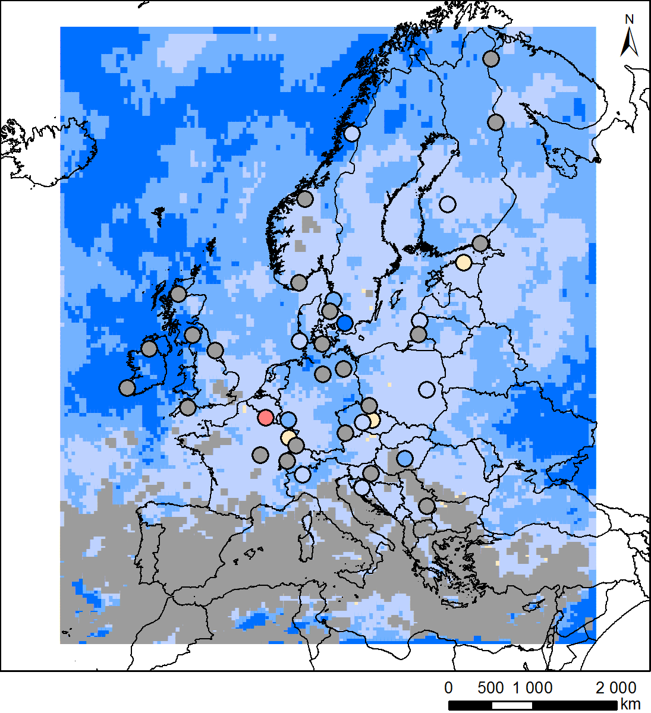
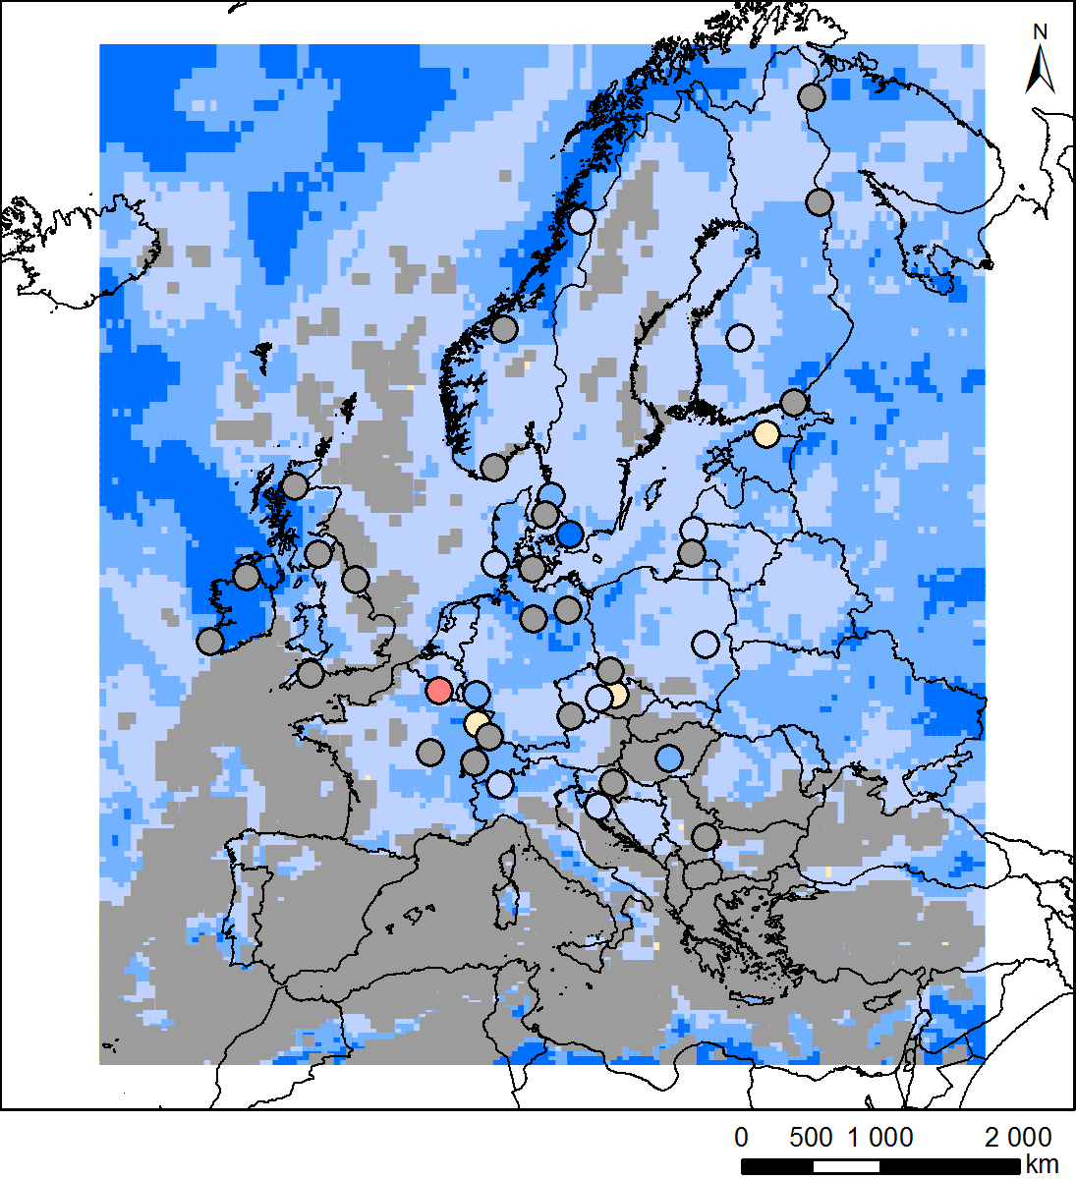
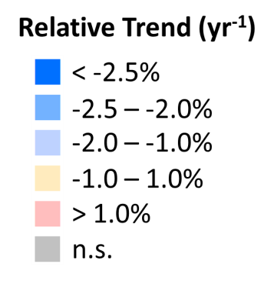
Spatial Distributions of Measured and Modelled Trends - WNOx
Chimere
EMEP MSC-W
Lotos-Euros
Notes:
Observed: About a third of trends are significant (one with increasing trend, FROO9R, Revin)
Modelled: Significant decreasing trends (except in the Mediterranean area)
All three models similar (although have individual features, e.g. larger CHIM trends in Germany)

Slide 11
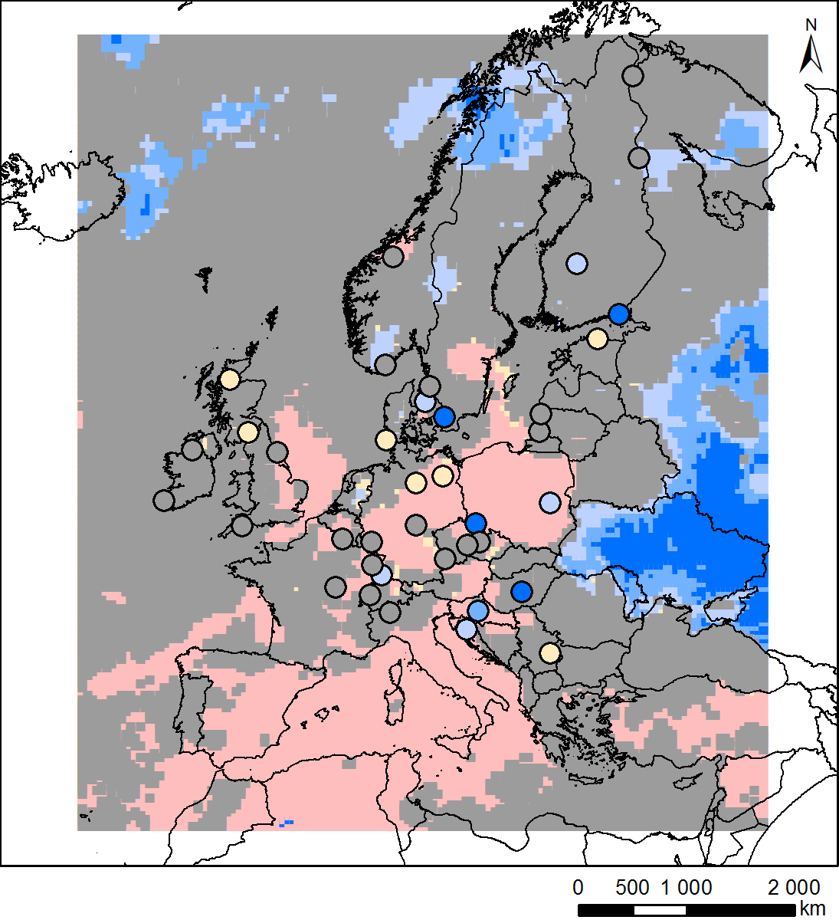
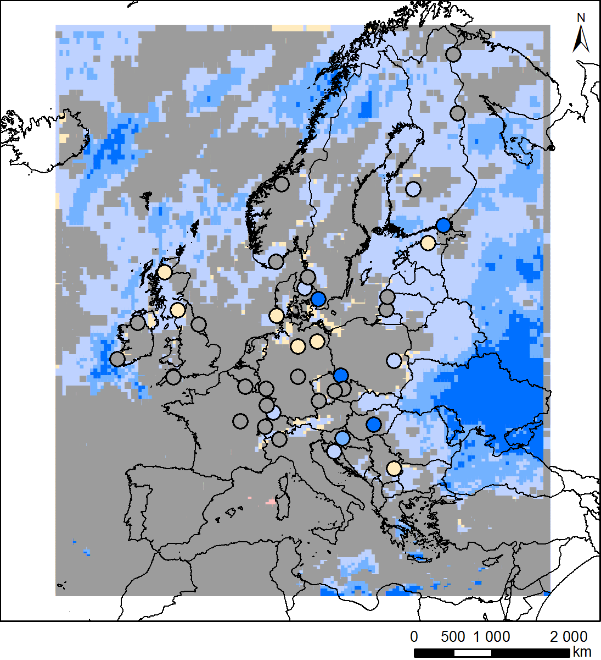
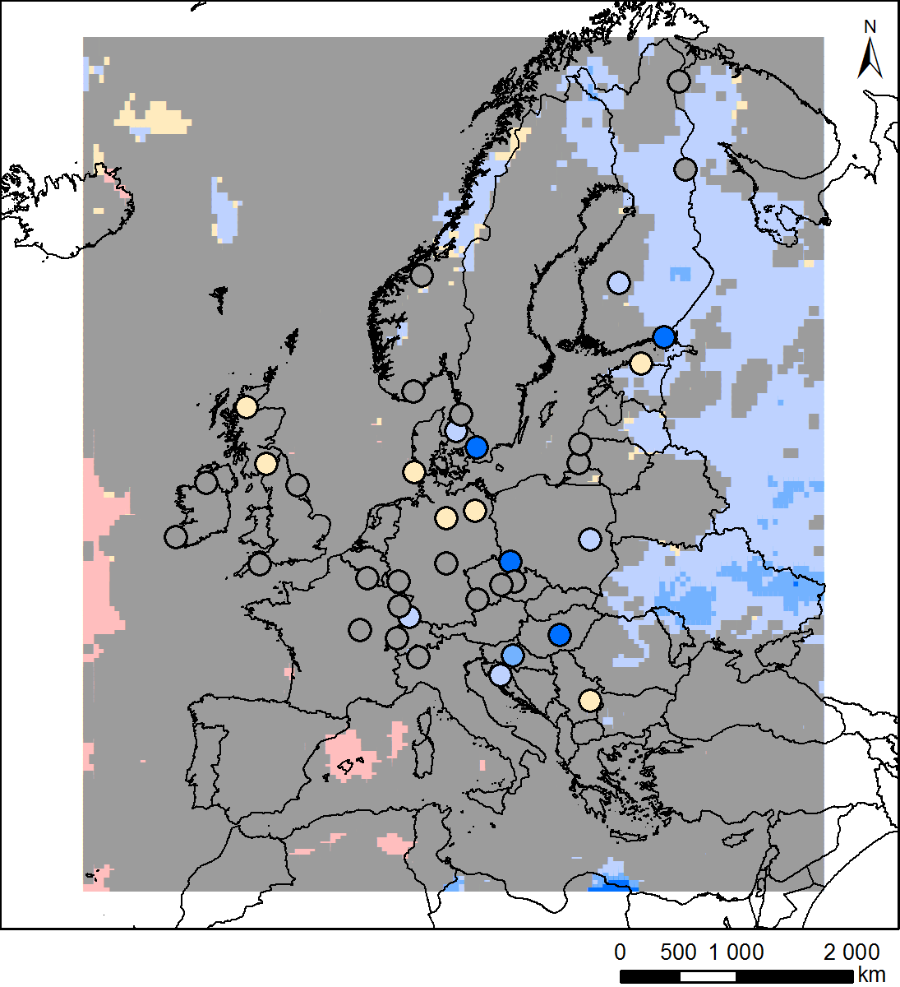
Spatial Distributions of Measured and Modelled Trends - WNHx
Chimere
EMEP MSC-W
Lotos-Euros
Notes:
Observed: about a quarter of trends are significant although about half of of those are very small (+/- 1%/yr)
Modelled: Mostly insignificant. All models predict a decrease in the East. CHIM predicts more significant increasing trends than the other models

Slide 12
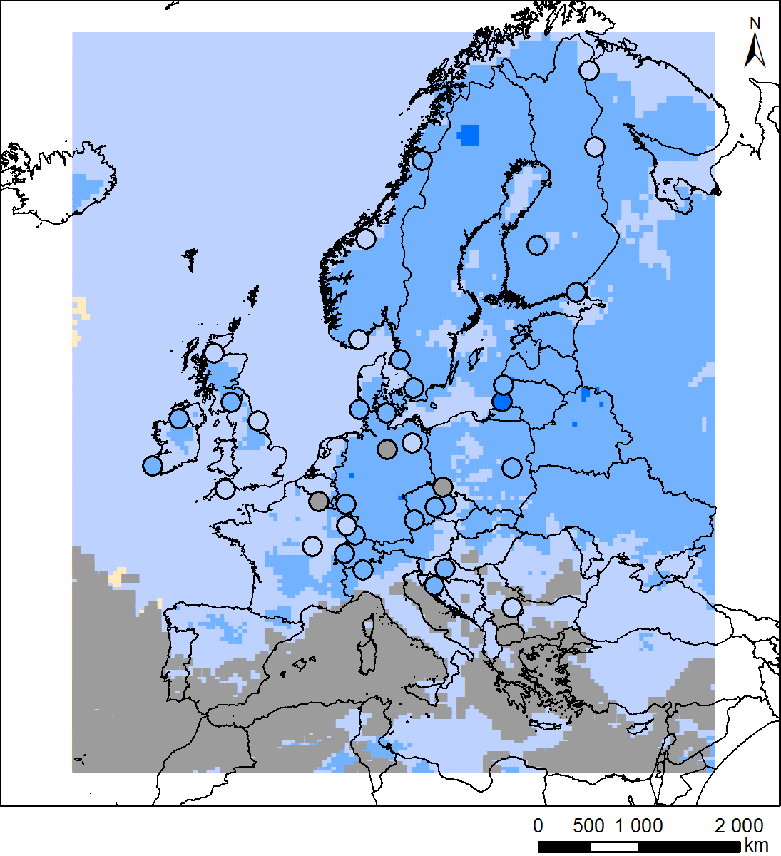
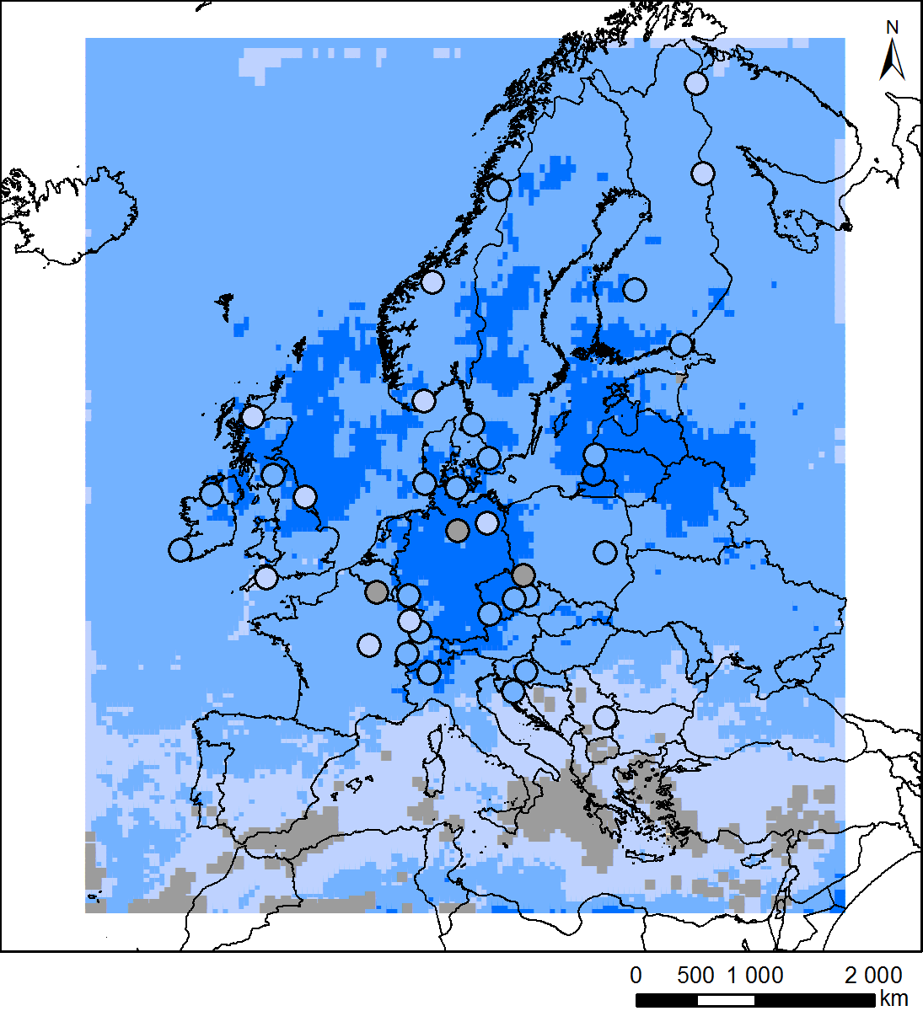
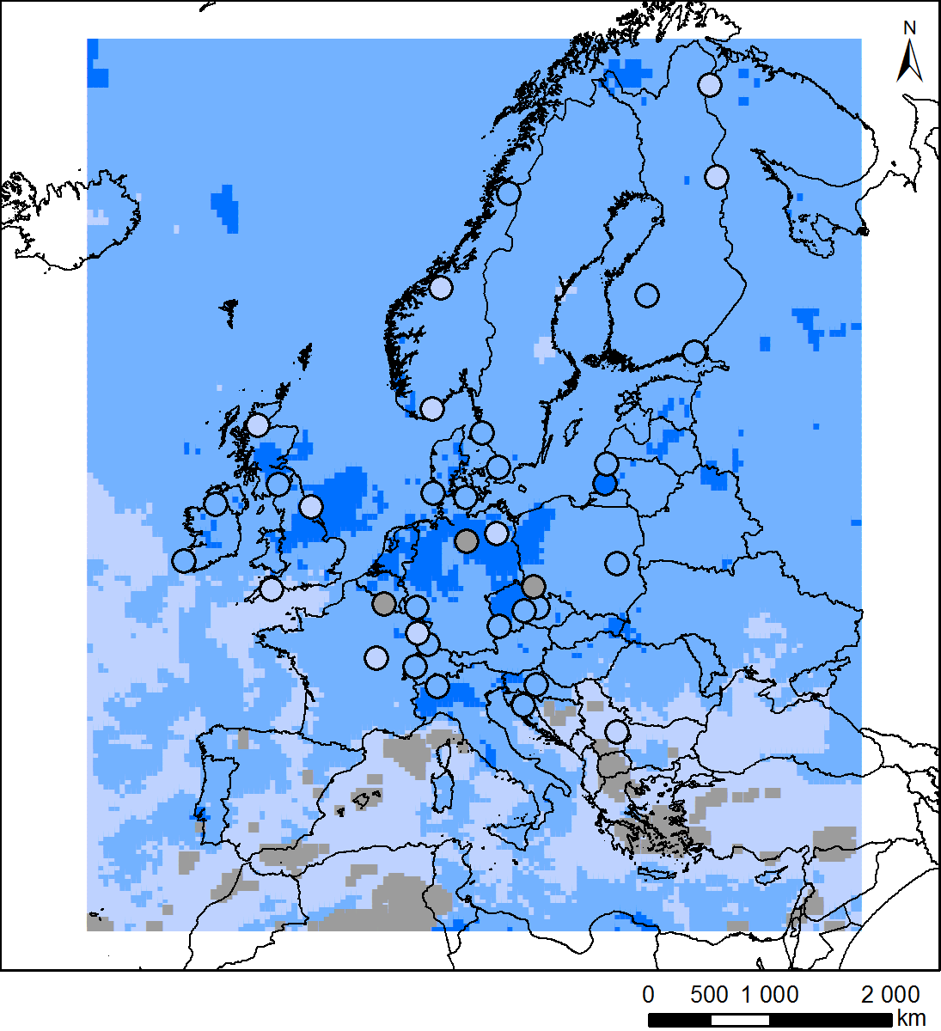
Spatial Distributions of Measured and Modelled Trends - WSOx
Chimere
EMEP MSC-W
Lotos-Euros
Notes:
Observed: Nearly all sites have significantly decreasing trends
Modelled: CHIM – smaller trends than EMEP/LOTO and more insignificant trends in Mediterranean. EMEP – larger trends than LOTO

Slide 13
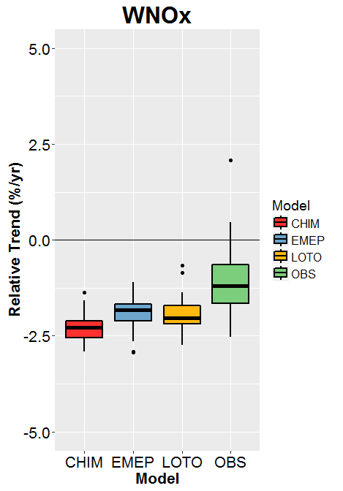
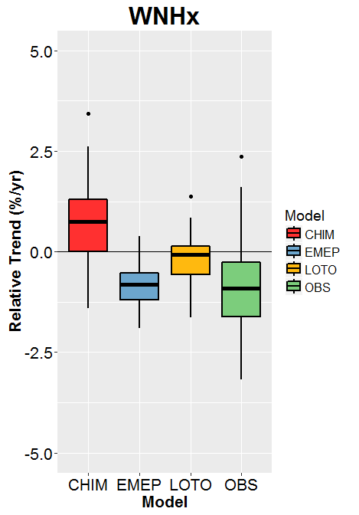
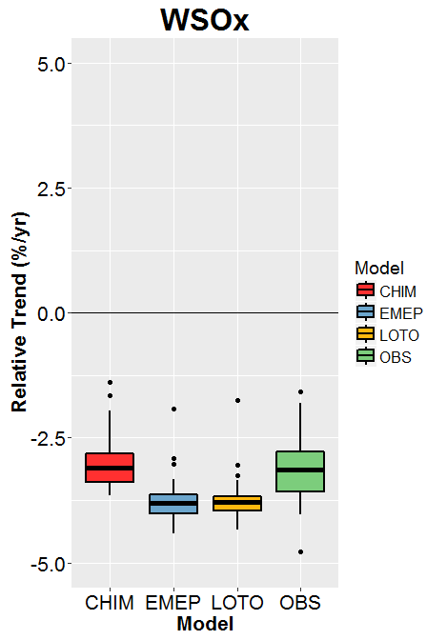
21 year time series (1990-2010) – Relative Trends
Notes:
Box plots of all relaltive trends (significant and insignificant)
WNOx: Most modelled trends larger than observed
WNHx: EMEP predicts similar distribution of trends to observed, LOTO predicts small trends and CHIM predicts increasing trends!
WSOx: Models and observations have decreasing trends although EMEP/LOTO overestimate most trends

Slide 14
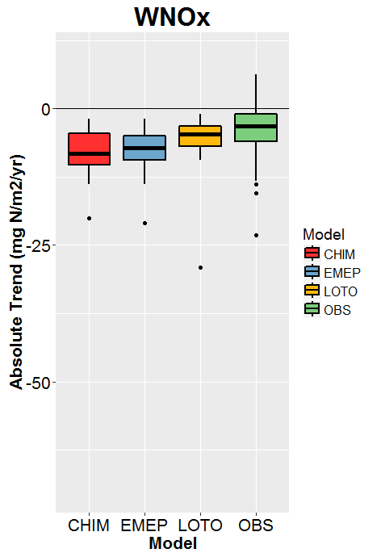
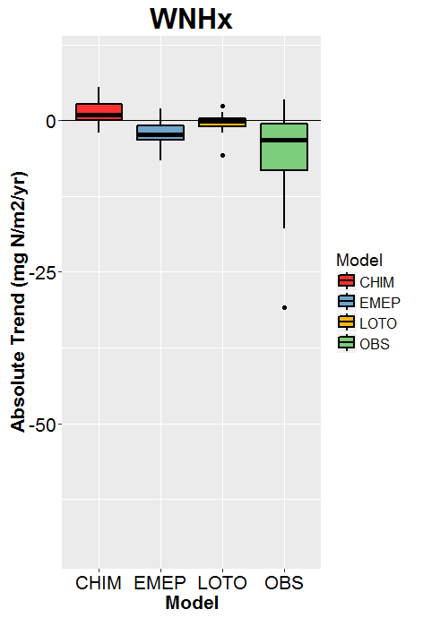
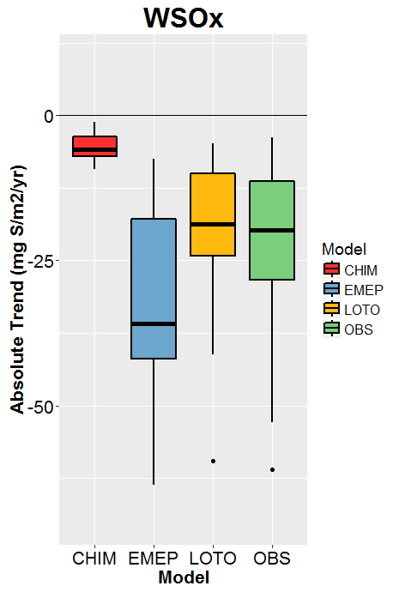
21 year time series (1990-2010) – Relative vs. Absolute Trends
Relative Trends
Absolute Trends
Notes:
Absolute trends tell a similar story to the relative trends except:
WNOx: LOTO gives better distribution of trends than EMEP, which now has similar distribution to CHIM
WSOx: CHIM strongly underestimates trends, LOTO very similar distribution to observed (better than EMEP)

Slide 15
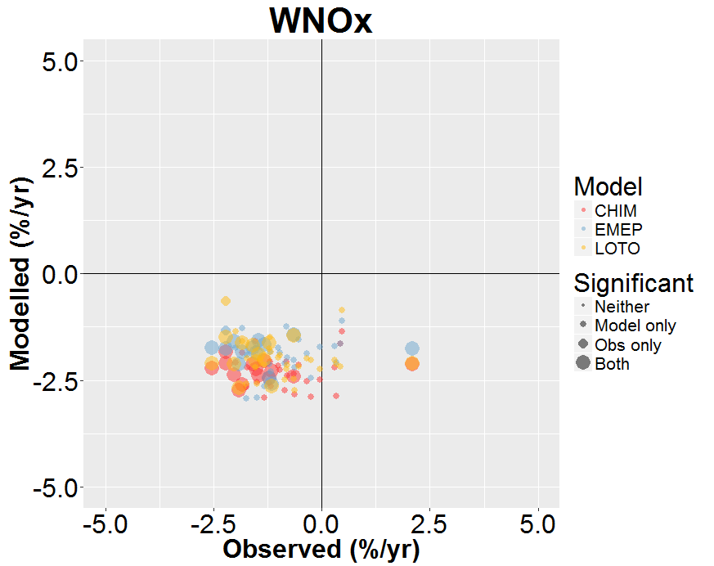
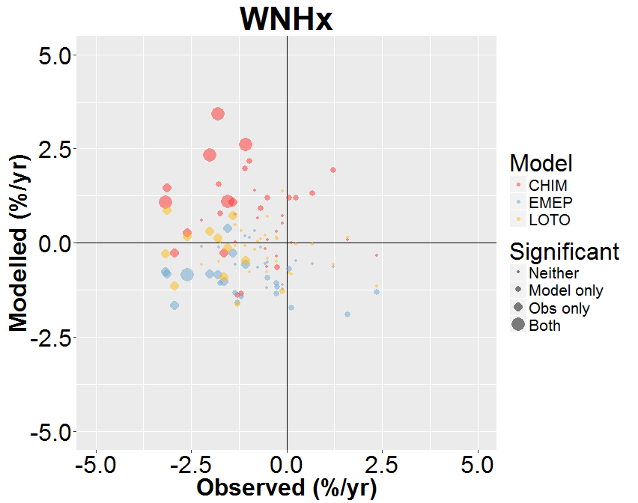
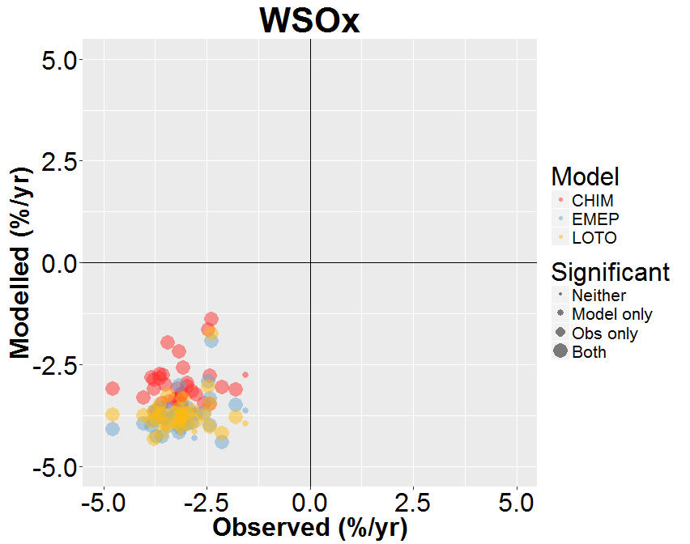
21 year time series (1990-2010) – Modelled vs Observed Trends
Notes:
All relative trends plotted (significant and insignificant)
WNOx: General agreement in direction of trend. All modelled trends are decreasing, whereas observations have increases at 4 sites (one significantly, FR009R, Revin)
WNHx: Disagreement between models and observations regarding the direction of trends (low significance)
WSOx: Strong agreement in direction of trend although correlation of trends is low

Slide 16
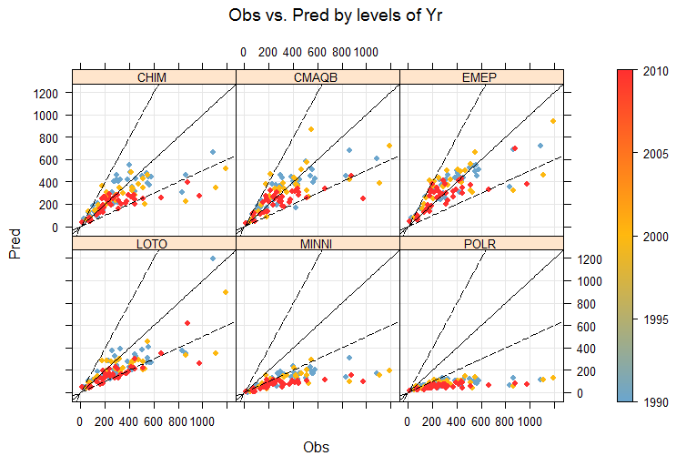
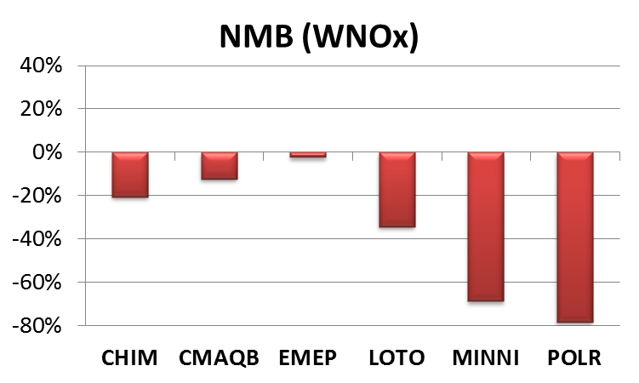
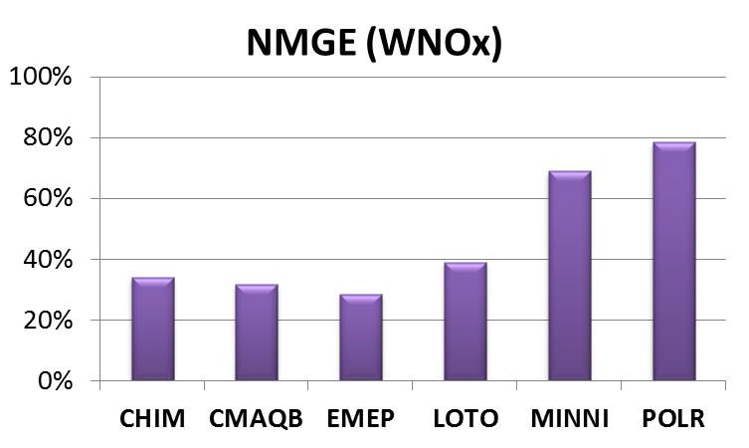
Model Performance (All 6 models) – WNOx (1990, 2000, 2010)
Notes:
Moving onto the analysis with the six nodels (1990, 2000, 2010 data only). For WNOx:
Normalised Mean Bias: All models underestimate deposition rates, on average (EMEP by only a few %)
Normalised Mean Gross Error: Most of the model error is due to the negative bias (except for CMAQB and EMEP)

Slide 17
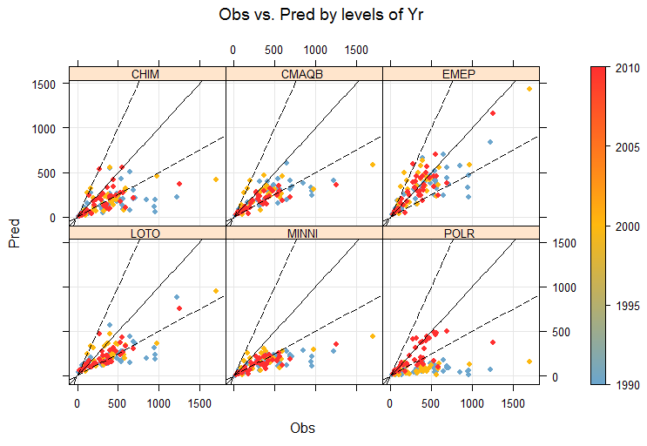
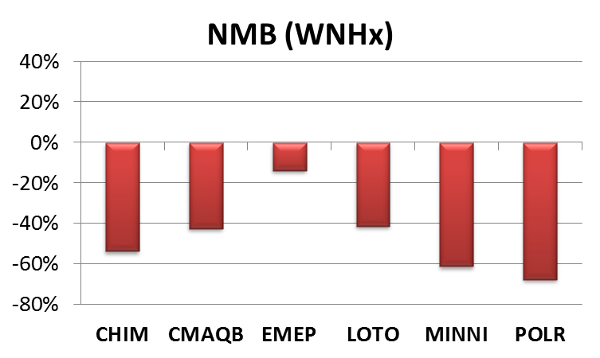
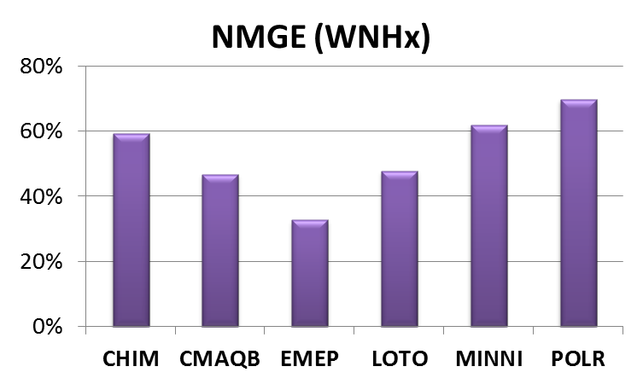
Model Performance (All 6 models) – WNHx (1990, 2000, 2010)
Notes:
Normalised Mean Bias: All models underestimate deposition rates, on average
Normalised Mean Gross Error: Most of the model error is due to the negative bias (except for EMEP)
POLR underestimates deposition rates for two of the years (1990 and 2000)

Slide 18
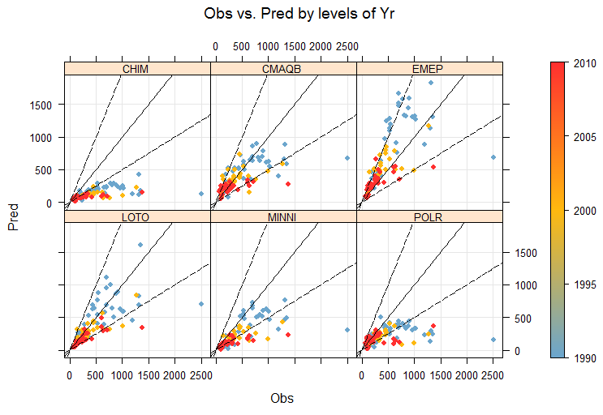
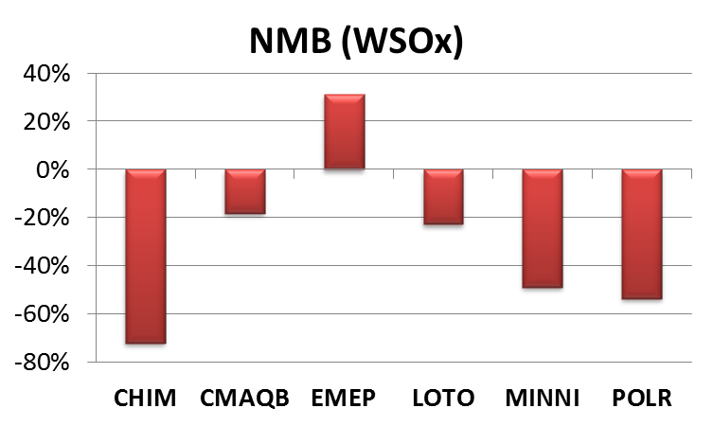
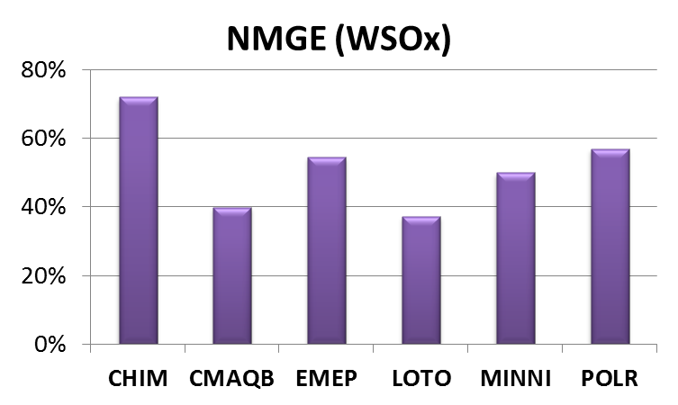
Model Performance (All 6 models) – WSOx (1990, 2000, 2010)
Notes:
Normalised Mean Bias: All models underestimate deposition rates, on average, except for EMEP (30% overestimate)
Normalised Mean Gross Error: Model error is mostly due to the bias (except for CMAQB)

Slide 19
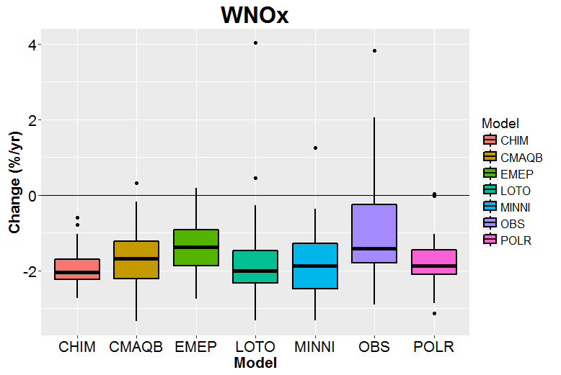
Change (1990-2010)
Notes:
With only 3 years of data we cannot calculated the trends and so we have calculated the change in deposition between 1990 and 2010
WNOx: Both observations and models predict a general decrease in deposition rates although the models tend to overestimate trends (except for EMEP)

Slide 20
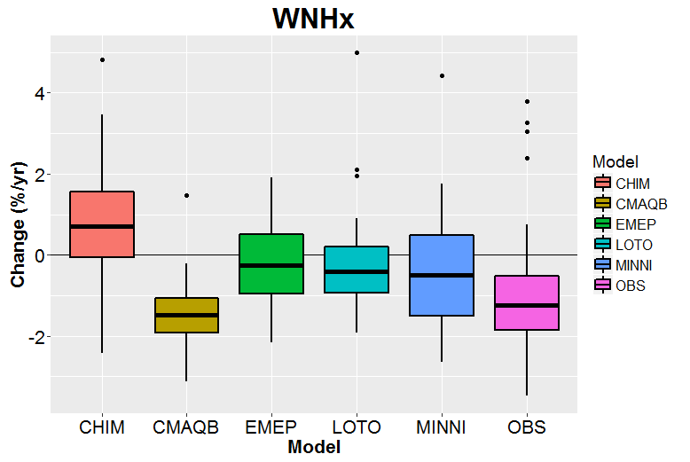
Without POLR
Change (1990-2010)
Notes:
WNHx: POLR predicts large increasing trends as a result of the underestimation for 1990
Observed trends are mostly decreasing. CMAQ predicts a similar trend distribution to that observed, EMEP, LOTO and MINNI underestimate trends and CHIM predicts mostly positive trends

Slide 21
Change (1990-2010)
Notes:
All trends (modelled and observed) are negative
Some models predict larger trends than observed (EMEP, LOTO and MINNI), some similar (CHIM and CMAQB) and POLR predicts smaller trends than those observed

Slide 22
Why do the modelled deposition rates differ between the models and between the models and the observations?
Wet deposition is influenced by (among other variables):
Atmospheric concentrations and precipitation rates
TNO3
TNH4
TSO4
Notes:
We have carried out a similar trend analysis for the atmospheric concentrations of total oxidised and reduced nitrogen, and sulphur in order to look at the relationship between the model estimates of wet deposition and the model estimates of the corresponding atmospheric concentrations

Slide 23
Wet deposition & Concentrations – Bias Compared
Oxidised N
Reduced N
Sulphur
Wet deposition
Concentrations
Notes:
Although we’re not going into detail of the model performance for concentrations (no time), we show here the model biases for both the wet deposition (top row) and atmospheric concentrations (middle row).
Generally, models underestimate wet deposition (except EMEP for WSOx) and overestimate concentrations
Therefore the overestimate of concentrations could be due to an underestimate of wet deposition (although other processes, such as dry deposition could also be important)
However, it is not the case that the models that underestimate deposition by the largest amount overestimate the concentrations by the largest amount, although this does seem to happen for WNHx (see scatter plots in bottom row)
Note CMAQ may include sea-salt sulphate, which may explain the high bias in TSO4 (but won’t explain the high bias in the other components)

Slide 24
Precipitation (mm yr⁻¹)
e.g. CHIMERE
Notes:
Another explanation for an underestimate of wet deposition could an underestimate of precipitation. However, as this plot shows, although there is a slight (7%) underestimate in precipitation in CHIMERE, this is not sufficient to explain a 20-70% underestimate in deposition (although it will contribute)

Slide 25
Influence of Meteorological Variability
Simulations with constant emissions (2010)
Mean of all sites
Notes:
Finally, in order to discount the effect of meteorological varibility on the long-term trends, we have also done the trend analyses for the simulations with constant (2010) emissions. As these plots show, the mean modelled deposition rate (averaged over all measurement sites) does not change significantly during this period
Note these are the old CHIM data. These simulations have not been done with the new version yet
25

Slide 26
Influence of Meteorological Variability
Simulations with constant emissions (2010)
Relative trends (1990-2010)
Notes:
..and as the box plots show:
WNOx: Models estimate mostly small increasing trends (significantly different to observed trends)
WNHx: Models estimate mostly small increasing trends (significantly different to observed trends)
WSOx: Models estimate mostly small increasing and decreasing trends (significantly different to observed trends)

Slide 27
Conclusions
The models tend to underestimate rates of wet deposition (EMEP by only a few % for WNOx, and overestimates WSOx) ; and overestimate atmospheric concentrations
WNOx Trends: Models tend to overestimate the observed relative decreases in deposition (modelled trends are more significant)
WNHx Trends: Observed and modelled relative trends smaller than those for WNOx (trends are also less significant)
WSOx Trends: Similar ranges for modelled and observed relative trends (the majority of which are significant)
Meteorological variability appears to have only a small influence on modelled trends

Slide 28
So: Questions to answer
Can the models estimate wet deposition for the period 1990-2010 with sufficient accuracy?
Can the models reproduce the observed trends in wet deposition?
What are the reasons for the differences between the models and between modelled and observed trends?

Slide 29
Thank you

Slide 30
Notes:
I suggest we end here!

